Slide 1
AI For Business Leaders Course
Project Steps: Delivering an ML/AI Strategy

Slide 2
AI for Business Leaders
Project Step 1 -
Prioritization Grid for all TeknoVe Business Cases

Slide 3
AI for Business Leaders
Project Step 2C
First Prioritization Grid

Slide 4
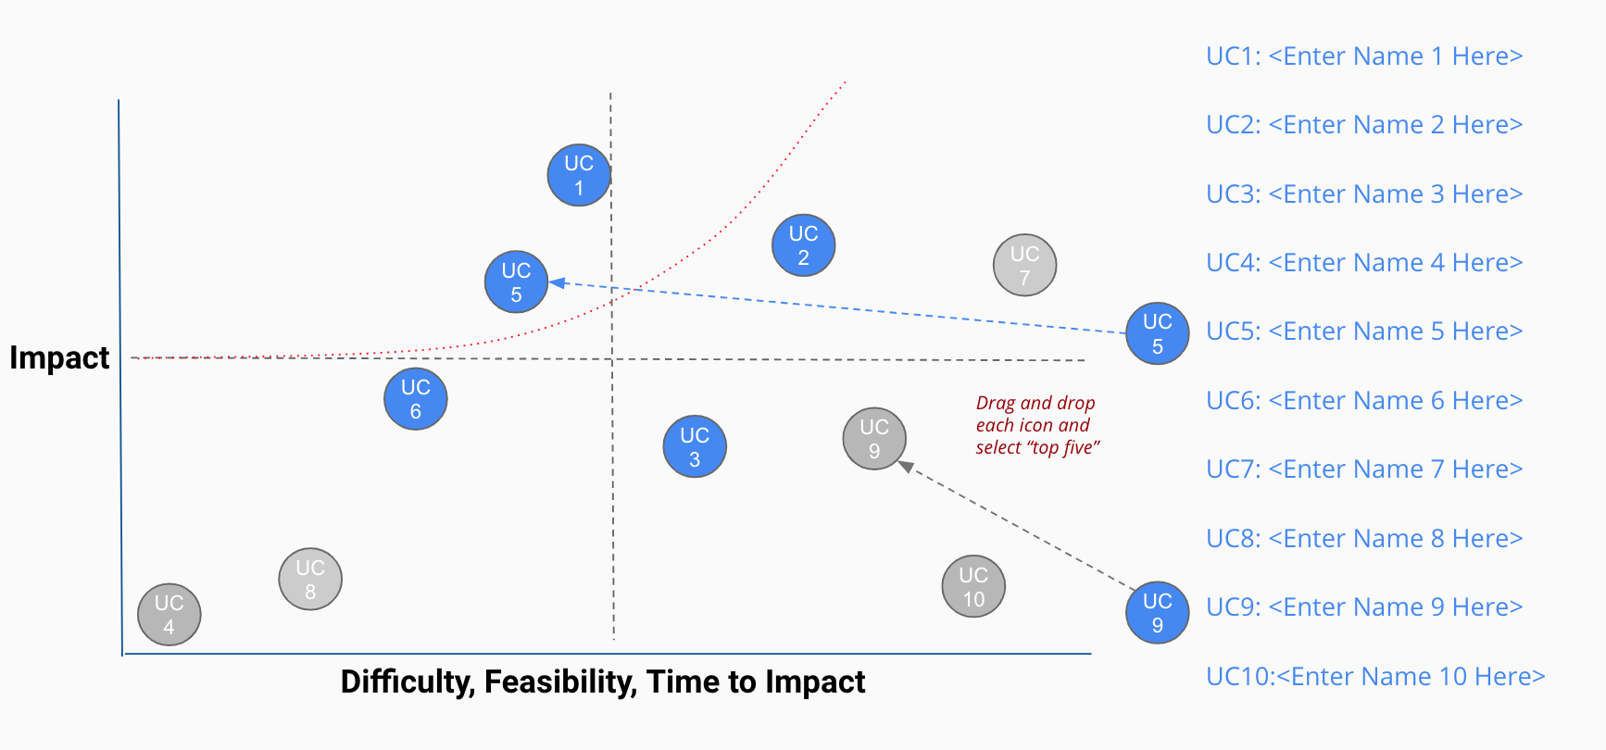
Your First Prioritization Grid
DIRECTIONS: For each of your use cases, review your answers to the 5V questions in Step 2A, and the operations you chose in Step 2B.
Then on the grid on the next slide, not this slide, move each blue use case icon to a place indicating how you see this use case’s impact and feasibility.
(Recall that the upper right quadrant is usually the most desirable, as it indicates we expect higher feasibility and greater impact.)
UC 2
Drag and drop icons for each use case
Remember to think about both axes!

Slide 5
First Prioritization Grid
(Follow directions on previous slide)
high
UC 3
UC 4
UC 1
UC1: <Computer Vision Quality Control>
UC 1
UC 5
UC 2
UC2: <AI-Enabled Predictive Maintenance>
Impact
UC 3
UC3: <Production Schedule Optimizer>
UC 2
UC 4
UC4: <Supplier Risk Predictive Intelligence>
UC 5
UC5: <Buyer Propensity Analyzer>
low
low
Feasibility
high

Slide 6
Now Prioritize and Eliminate Three Use Cases
1) Review the locations of your use cases on the grid on the previous slide. Remember we want to prioritize use cases for AI and ML that offer the greatest impact for the least difficulty.
2) Now in the grid on the previous slide change the color from blue to grey for two use case circles you want to de-prioritize.
3) This leaves your top three use cases in blue that you want to move forward with in the rest of the project.

Slide 7
Nice work, you’ve completed Step 2C of the project!

Slide 8
AI for Business Leaders
Project Step 3
Architectures for Top 3 Use Cases

Slide 9
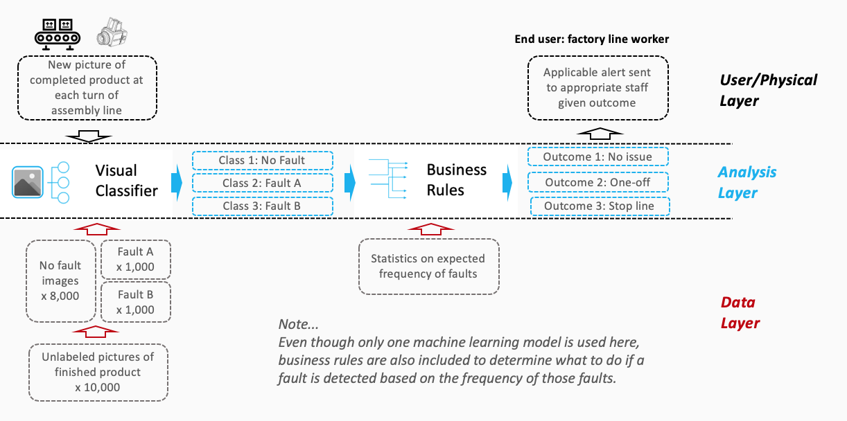

Creating High Level Architectures
Sample Completed Architecture
For the top three use cases you prioritized in Project Step 2C, you’ll now create a high level architecture for each, on slides 10-12.
For this step, be sure to review Lesson 3 but also recognize that this process allows significant creative freedom.
Keep a focus on… - Data flow/direction - Clear view on inputs/outputs - Simplicity
Write the use case name at the top of each slide.
Do all work on slides 10-12:
Copy and paste capabilities from slide 9 into Analysis Layer
Identify relevant User/Physical and Data Layer attributes
Copy and paste arrows from slide 9 to show data flow, input/output
Use annotations to help explain difficult concepts

Slide 10

















Your AI/ML Toolkit - List of Capabilities
Generic ML Capabilities
Natural Language Processing
Voice/Speech Processing
Computer Vision
Other Capabilities
Drawing Tools
User/Physical Layer
Analysis Layer
Data Layer

Slide 11
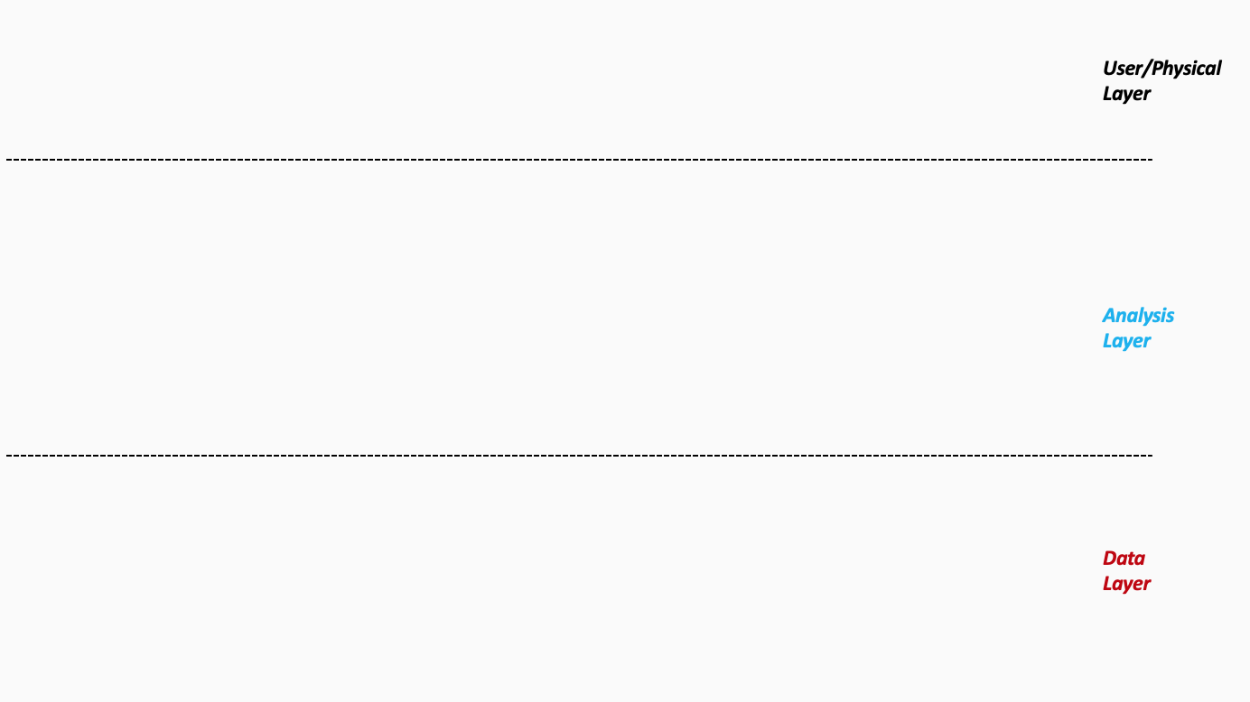
Production Team
Architecture 1/3 - <Production Schedule Optimizer>
Plant Managers will be better able to plan schedule, staffing and ordering materials
Plant personnel
Production Schedule
Optimized Production Schedule at each plant
Materials Required
Raw Material Stock at each location
Resources Required
Finished Inventory at each location
Time Required
EV’s required at each Location
Production Costs
Switching Costs
Transportation Costs
Demand Estimates
Sales team provides demand estimates by location
Notes:
Please follow the directions on slide 8. Copy and paste the desired icons provided you on slide 9 onto this page.

Slide 12
Procurement Team
Architecture 2/3 - <Supplier Risk Predictive Intelligence>
Daily News Articles
Risk scores compared with tolerance levels and risk assessment performed to reroute supplies
Event1
Risk Score
Event 2
Event 3
Event 4
Global Related Supply News
Newly tagged articles fed back to the history to verify accuracy and ground truth by “human in the loop”
5 yrs. News Articles
Tagged and Classified
Innovation team sourced 10000 articles from last 5 years
Notes:
Please follow the directions on slide 8. Copy and paste the desired icons provided you on slide 9 onto this page.

Slide 13
Sales Team
Architecture 3/3 - <Buyer Propensity Analyzer>
Buyer propensity times footfalls will help in estimating market demand. Technove will be able to determine need for new location.
Demand Estimates
Class 1
Propensity to Buy
Buyer Propensity Score
Customers in new locations are segmented using clustering techniques
Class 2
Class 3
Buyer Propensity Model
Class 4
Back testing to improve demand estimates by 5%
Customer Demographics of new locations
Customer Sales History
Customer Demographics History
Notes:
Please follow the directions on slide 8. Copy and paste the desired icons provided you on slide 9 onto this page.

Slide 14
Excellent, you’ve completed Step 3 of the project!

Slide 15
AI for Business Leaders
Project Step 4C
Second Prioritization Grid

Slide 16
Your Second Prioritization Grid
Based on new information from your further analyses of your use cases in step 4A and 4B, you’ll engage in the same exercise as you did before in Step 2C to update your prioritization.
Move onto the grid the three use cases that you have been working with in steps 4A and 4B.
You MAY choose different use cases and shift your focus, if you feel these exercises have caused you to significantly revise your prior evaluations.
UC 2
Drag and drop icons for each use case
Remember to think about both axes!

Slide 17
Second Prioritization Grid
high
UC 3
UC 1
UC1: <Computer Vision Quality Control>
UC 5
UC 2
UC2: <AI-Enabled Predictive Maintenance>
UC 1
UC 4
UC 3
UC3: <Production Schedule Optimizer>
Impact
UC 4
UC4: <Supplier Risk Predictive Intelligence>
UC 2
UC 5
UC5: <Buyer Propensity Analyzer>
low
Note: You only need to locate three of these onto the grid.
low
Feasibility
high

Slide 18
Now Prioritize and Eliminate One More Use Case
1) Review the locations of your use cases on the grid on the previous slide. Remember we want to prioritize use cases for AI and ML that offer the greatest impact for the least difficulty.
2) Now in the grid on the previous slide change the color from blue to grey for one use case circle you want to de-prioritize.
3) This leaves your top two use cases in blue that you want to move forward with in the rest of the project. But you may still change these later.

Slide 19
Terrific, you’ve completed Step 4C of the project!

Slide 20
AI for Business Leaders
Project Step 5
Operational Considerations:
Accuracy, Bias, and Ethics

Slide 21
Accuracy, Bias, and Ethics Concerns
For each of your two remaining use cases, on the next two slides please write 2-3 paragraphs discussing how success will be measured and monitored.
Start by focusing on how model effectiveness would be measured, and speak to what success would look like.
Comment on any other operational concerns, including bias in the data, or ethical limitations, that could influence success.
For each concern you raise, comment on how you would measure or monitor this concern on an ongoing basis.

Slide 22
Production Schedule Optimizer
Model Effectiveness: The Production Schedule Optimizer tries to optimize the number of EVs to be produced for each location that would result in lesser switching and inventory costs. Hence a performance measure suitable for such optimization techniques such as upper bound and lower bound cost values baselined for normal production of a certain number of EV model could be used to compare the optimized numbers. RMSE measures for switching, transportation and inventory costs and predicted numbers to be produced can be evaluated for optimal projections.
Accuracy, Bias and Ethical considerations: Since the VP of Supply Chain has extensively collected cost data from factories across the globe, there is less chance of bias in the data collection. However, since the optimization model depends on the market demand which has proven inaccurate in the past there is a chance of bias or underfitting in the optimization model.
Market demand will change over time. Production Schedule Optimizer depends on market demand and has a chance of suffering from data drift as real time data will start losing relevance to the data on which the model was trained.
There are no significant ethical considerations that needs to be taken into account for success of the model as it is used only for optimization of costs and not towards any unfair bias or discrimination even inadvertently.
Measure and Monitor: Since inaccuracies in the market demand can result in bias in the model leading to underfitting, C-suite must be encouraged to consider developing the Buyer Propensity Analyzer to mitigate this risk. Further market demand has to be closely tracked, monitored to sustain optimizer performance

Slide 23
Buyer Propensity Analyzer
Model Effectiveness: The Buyer Propensity model tries to estimate the probability that a buyer will purchase a EV model based on similar existing customer sales, demographics and buyer patterns. Customer segmented data is then used by a regression model to determine a buyer propensity score. Model effectiveness is determined again by RMSE or R2 measures which are statistical comparisons for predicted vs actual numerical scores(based on existing data).
Accuracy, Bias and Ethical considerations: Since TechnoVe is a cutting edge EV manufacture whose products are more appealing to Millennials, the customer data collected so far seems to be biased towards age as a result of which the model accuracy plummeted since demographics of new locations were different. TeknoVe must correct this bias to prevent underfitting for any chance of the model to be successful.
As new locations are added, demographics will change and this will lead to underlying data drift in the model. The model will start losing significance if it is not updated for the underlying data changes.
There are some ethical considerations that needs to be taken into account for success of the model. The model inadvertently leads to discrimination because of the age related bias and will model new store locations only in places with millennial crowd. This can be harmful to the image of TechnoVe.
Measure and Monitor: Since bias in the age related demographics and buyer patterns can lead to inaccuracies in the model and ethical issues, TechnoVe must closely monitor model performance and take decisions on appropriate store locations to rectify data drift and balance ethical considerations.

Slide 24
Well done! You’ve completed Step 5 of the project!

Slide 25
AI for Business Leaders
Project Step 6B
Feedback and Final Prioritization Grid

Slide 26
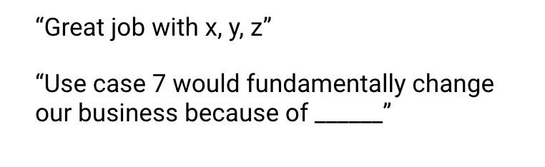
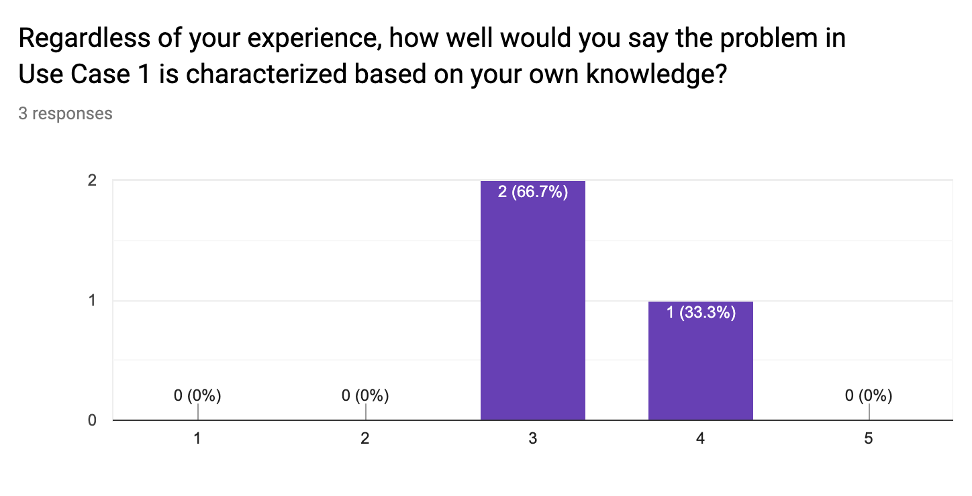
Feedback Visualization
Verbatim Quote Example
Depending on how you chose to gather feedback -- survey, phone call, etc. -- you will have a mix of quantitative and qualitative results.
Use the following pages to document your key takeaways in the form of verbatim quotes and visualizations.
For verbatim quotes, you should use direct quotes that indicate the support and critiques you encountered.
For visualizations, feel free to use the graph provided in your Google Form.
Visualization Example

Slide 27
Verbatim Quotes - <Production Schedule Optimizer>
“Use case 3 – Production Schedule Optimizer will transform the way Technove manufactures EV. Efficiency in costs and inventory will be brought about based on market demand predictions”
“Production Schedule Optimizer will fundamentally change how plant production schedules are managed and controlled”
“Production Schedule Optimizer will overhaul inventory management and plant reconfigurations”

Slide 28
Visualization - < Production Schedule Optimizer>

Slide 29
Verbatim Quotes - <Buyer Propensity Analyzer>
“Use case 5 – Buyer Propensity Analyzer will fundamentally change the way TechnoVe looks at marketing.
“Buyer Propensity Analyzer will use a data driven predictive approach to help TehcnoVe indetify new store locations as opposed to concentrating only on urban clusters”
“The model will help TechnoVe acquire a targeted and precise marketing strategy”

Slide 30
Visualization - < Buyer Propensity Analyzer >

Slide 31
Your Final Prioritization Grid
Based on the feedback you’ve gathered, and all of the previous information for each use case, you’ll now engage in the same prioritizing exercise as you have twice before.
You MAY choose to re-prioritize use cases and shift your focus if you feel these exercises have caused you to significantly revise your prior evaluations.
At the end of this exercise, you should have a final point of view on the use cases you’ll advocate in your ML/AI strategy!
UC 2
Drag and drop icons for each use case
Remember to think about both axes!

Slide 32
Final Prioritization Grid
high
UC 3
UC 1
UC1: <Computer Vision Quality Control>
UC 2
UC2: <AI-Enabled Predictive Maintenance>
UC 5
UC 3
UC3: <Production Schedule Optimizer>
Impact
UC 4
UC4: <Supplier Risk Predictive Intelligence>
UC 5
UC5: <Buyer Propensity Analyzer>
Note: You only need to move 2 of these use cases onto the grid.
low
low
Feasibility
high

Slide 33
Nice work, you’ve completed Step 6B of the project!

